Slide 1
Part to Whole: Overview and Best Practices
John F. Tripp

Slide 2
Part to Whole
Definition
  The relationship of a proportion of a whole to itself
Key Terms
  Rate or rate of total
  Percent or percentage of total
  Share
  “Accounts for X percent”

Slide 3
“Not Wrong” Graphs – Pie Chart
Pie chart is the most commonly used AND MISUSED chart for part-to-whole visualization.
They are intuitive, but should be used only in narrow cases

Slide 4
Pie Charts – The Bad
Graphs like this give pie charts a bad name.
  Doesn’t add up to 100%
  Slices are all equal, while percentages differ.
  Pizza image is design element – not quantitative element.

Slide 5
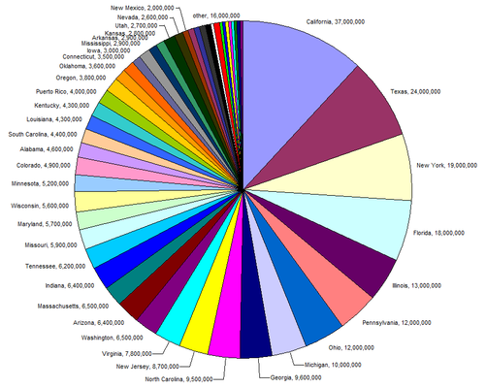
Pie Charts – The Bad

Slide 6
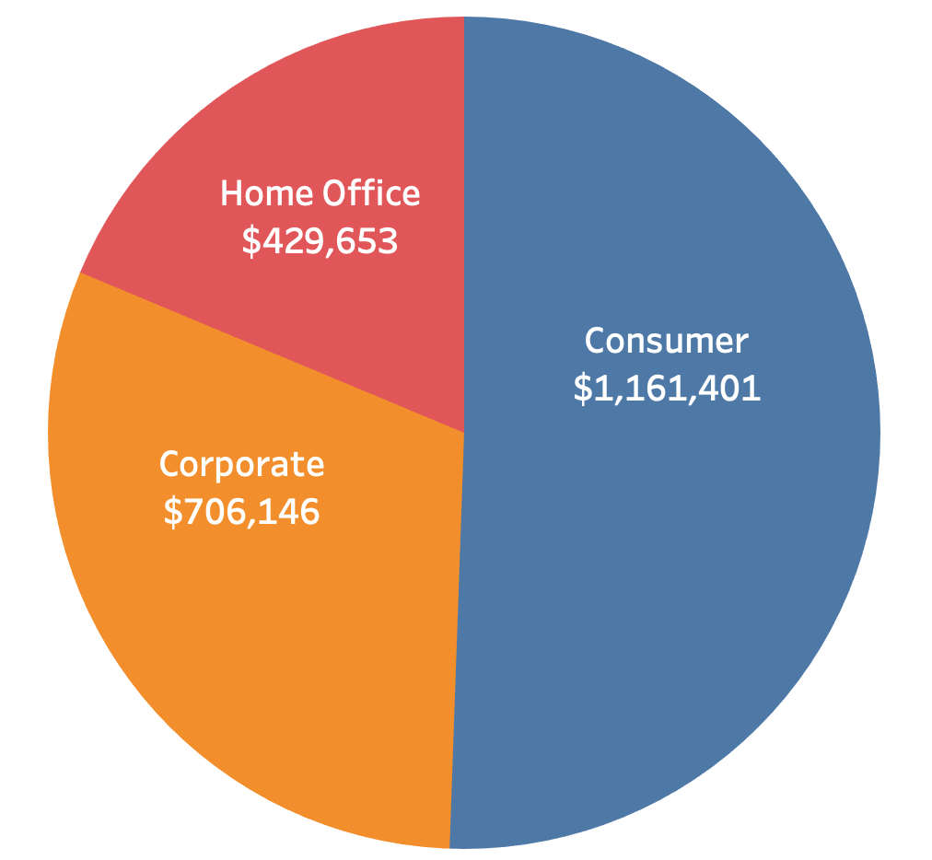
Pie Charts – The Good
Use a pie chart with:
  No more than 3 slices
  Slices are clearly different size
  Continuous Data
    NOT ordinal data
Always show 100% of the whole
No 3-D
No Exploded Slices
All positive numbers
Never multiple pie charts

Slide 7
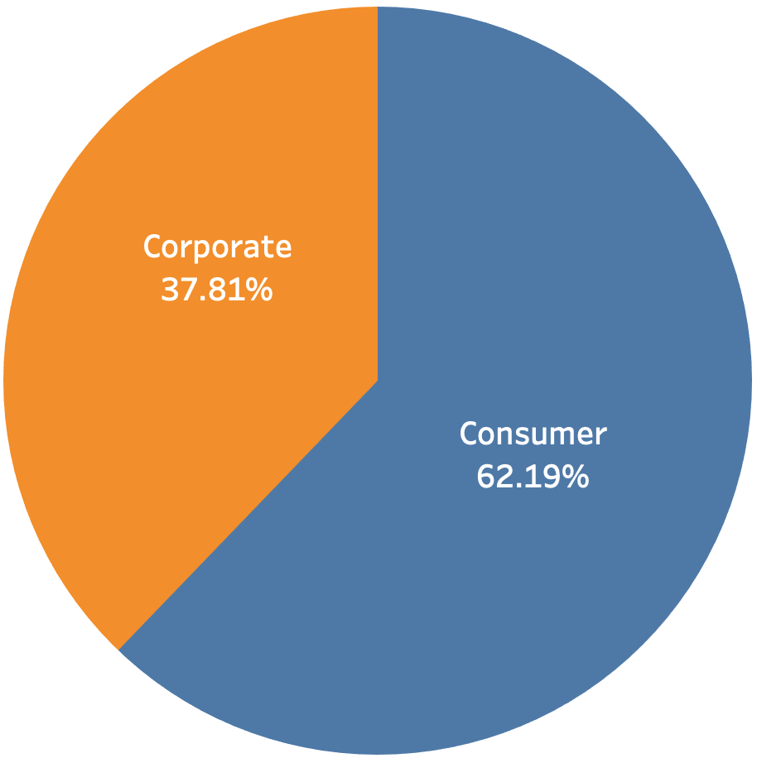
Pie Charts – Always show 100%

Slide 8
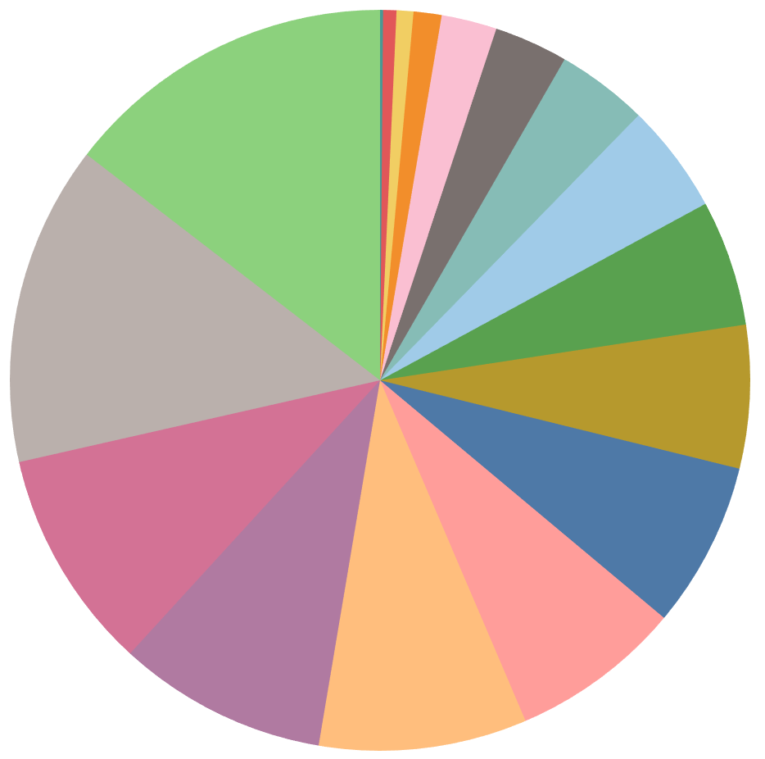
Pie Charts – Three slices or fewer

Slide 9
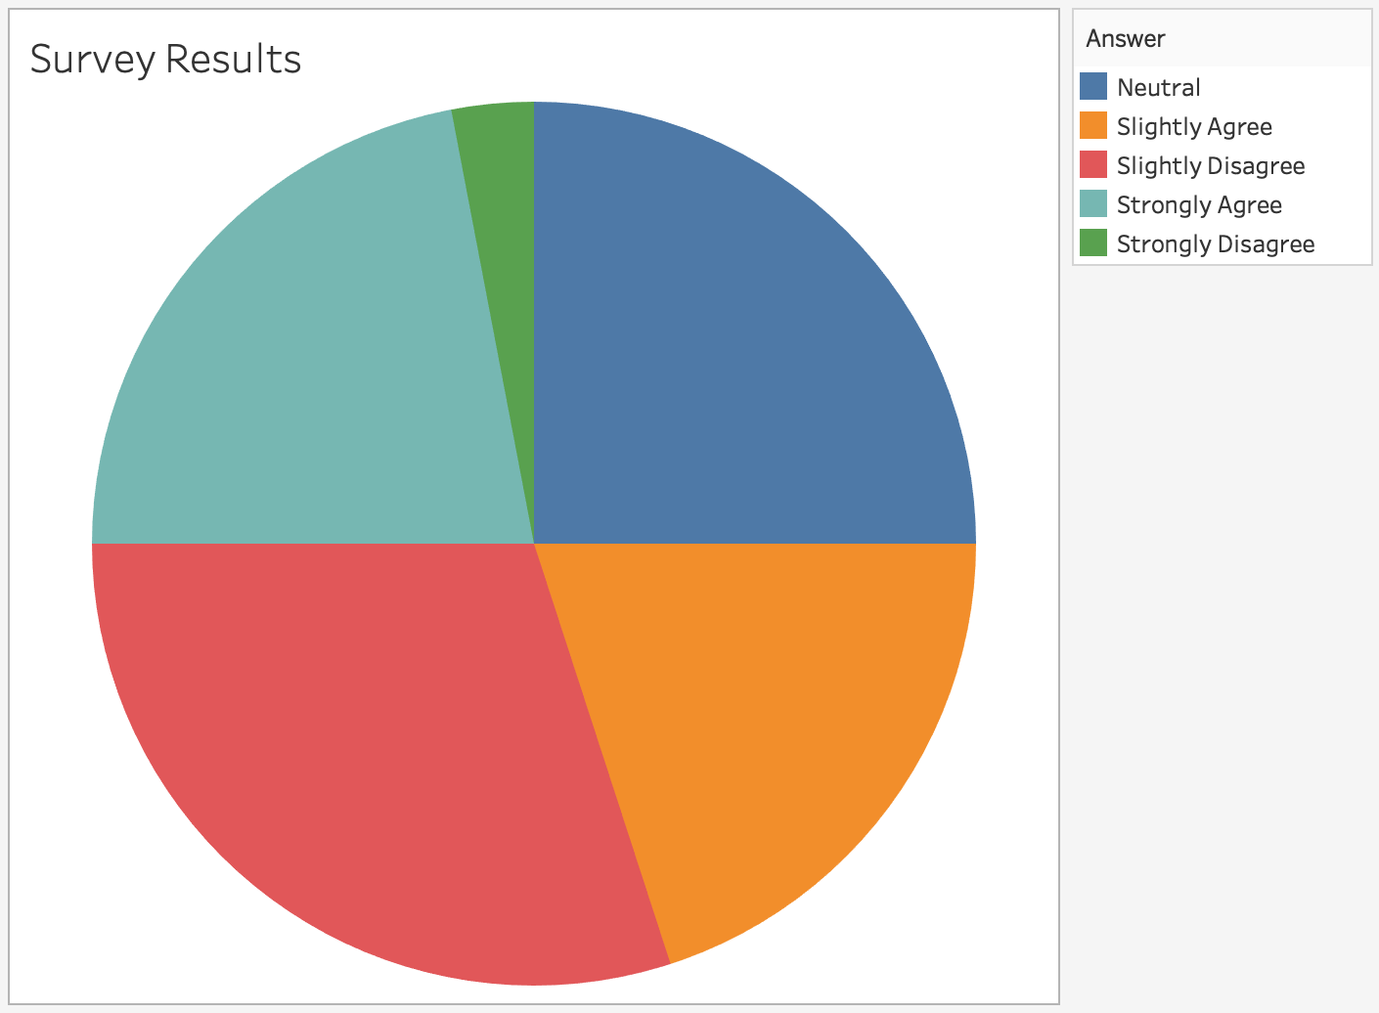
Pie Charts – Continuous, Not Ordinal

Slide 10
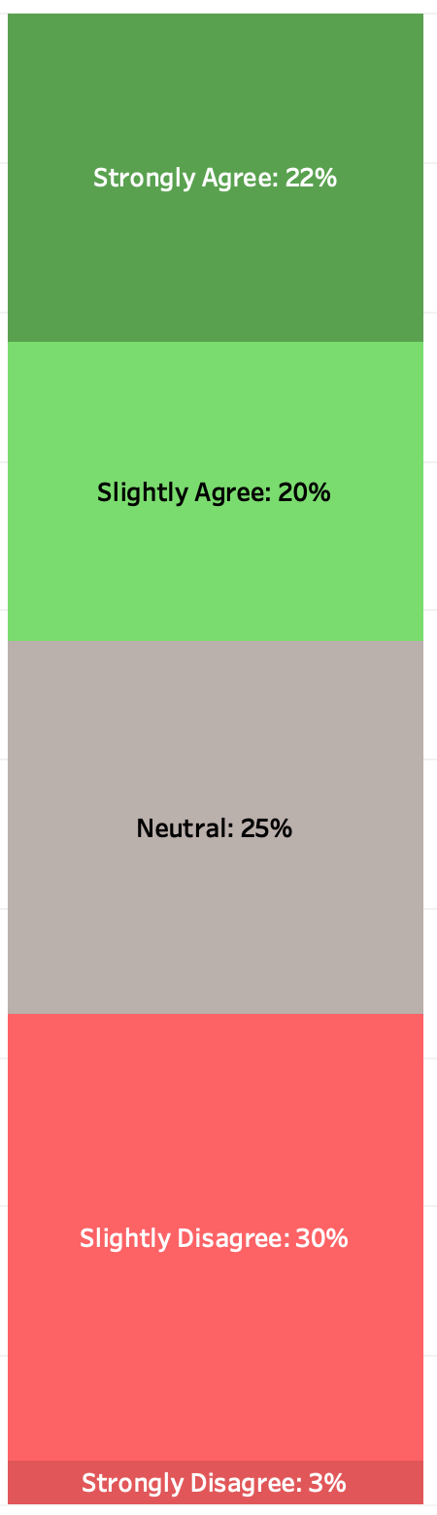
Pie Charts – Continuous, Not Ordinal

Slide 11
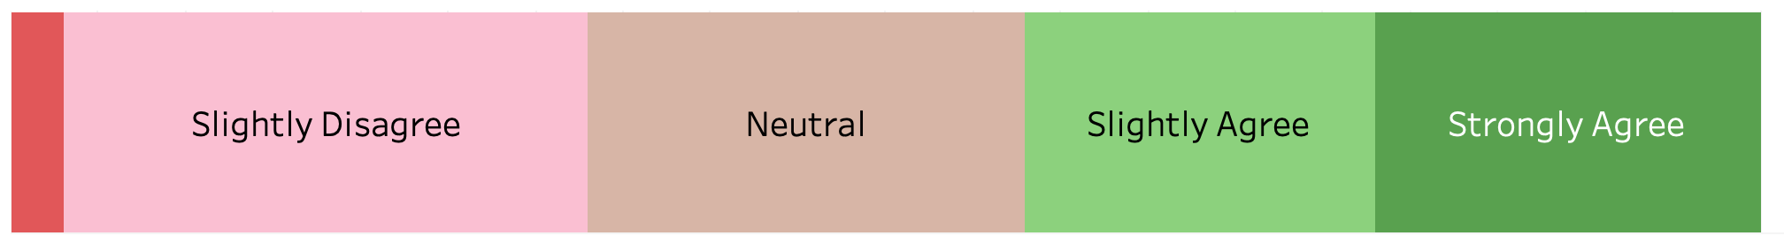
Pie Charts – Continuous, Not Ordinal

Slide 12
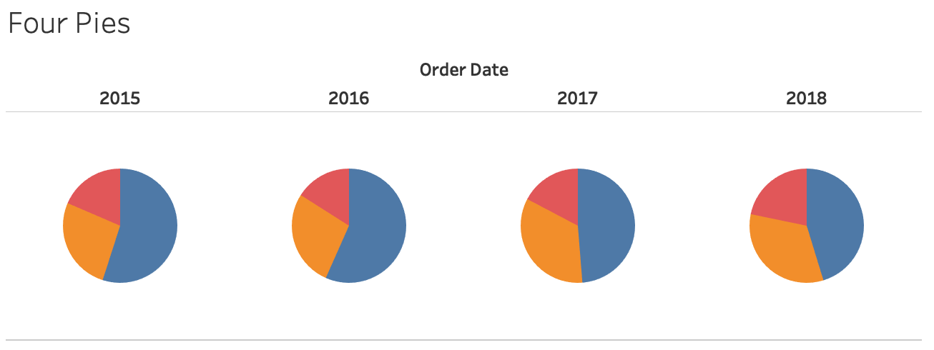
Pie Charts – No Multiples

Slide 13
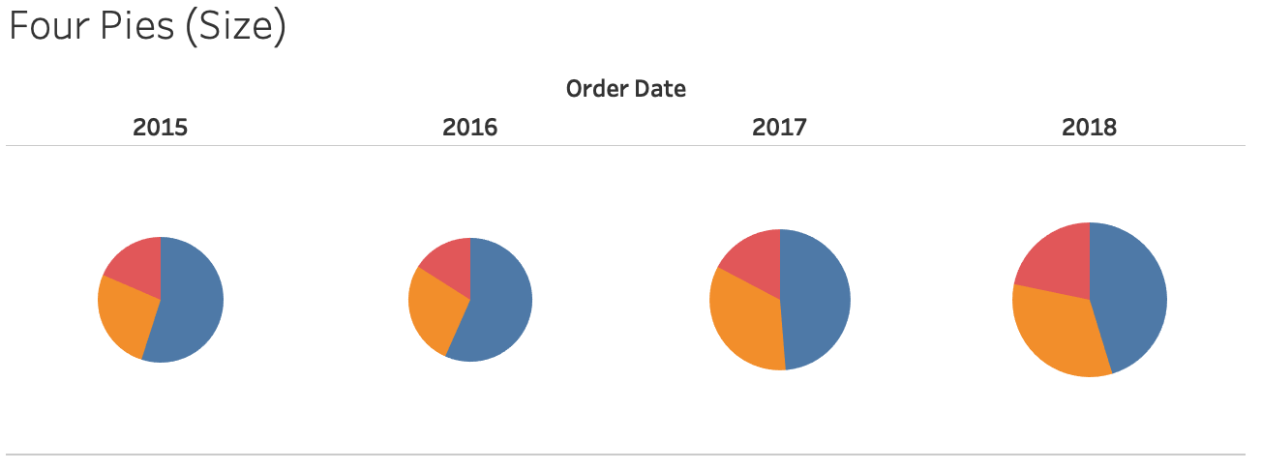
Pie Charts – No Multiples

Slide 14
“Not Wrong” Graphs – Stacked Column Chart
Stacked Column Charts are excellent alternative to pie charts, especially when you need to compare multiple parts-to-whole

Slide 15
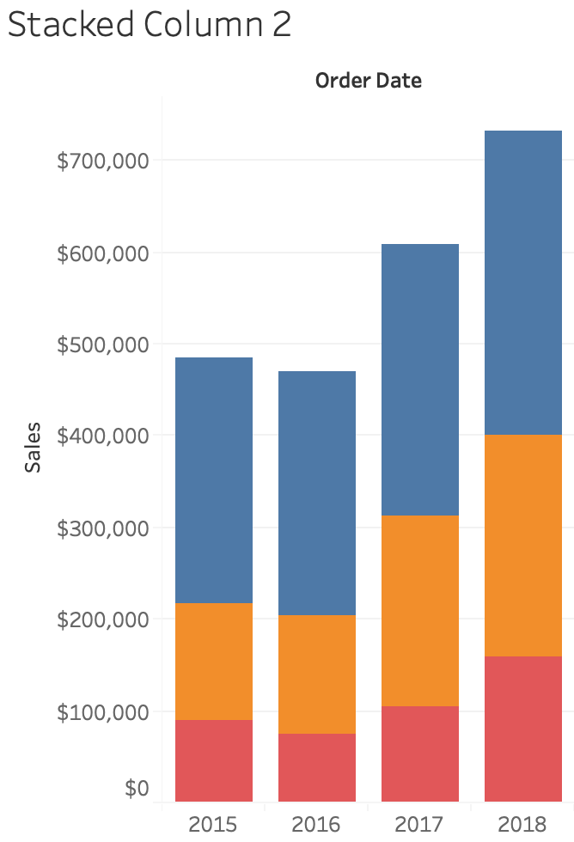
“Not Wrong” Graphs – Stacked Column Chart

Slide 16
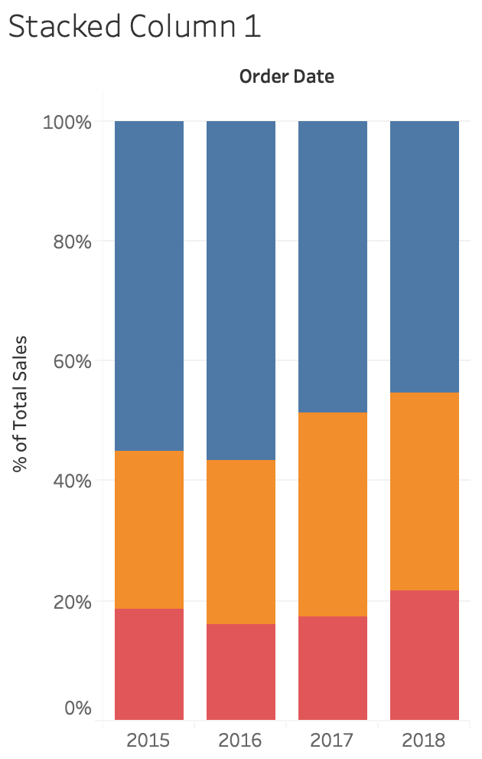
“Not Wrong” Graphs – Stacked Column Chart

Slide 17
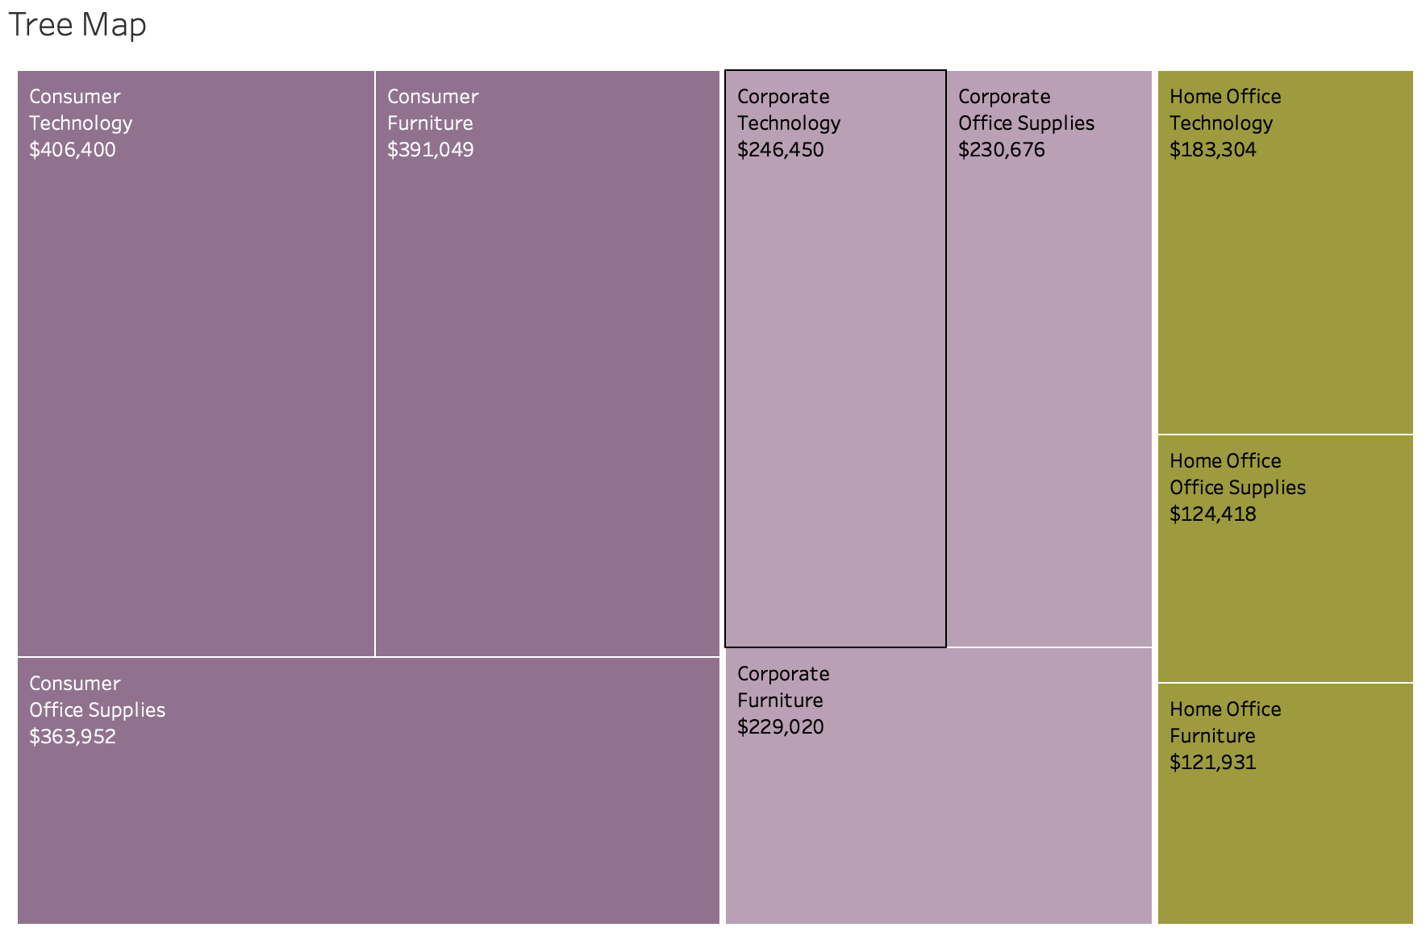
“Not Wrong” Graphs – Tree Map

Slide 18
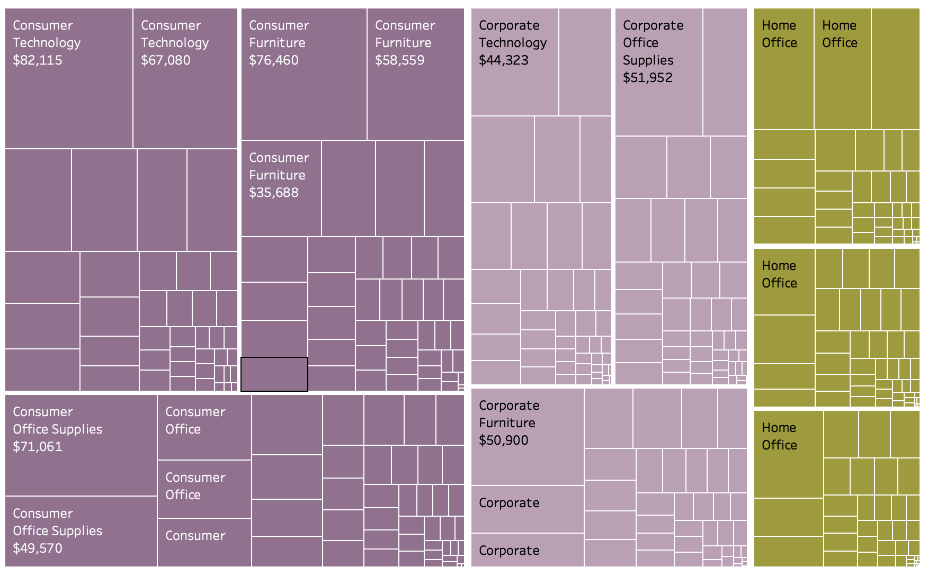
“Not Wrong” Graphs – Tree Map

Slide 19
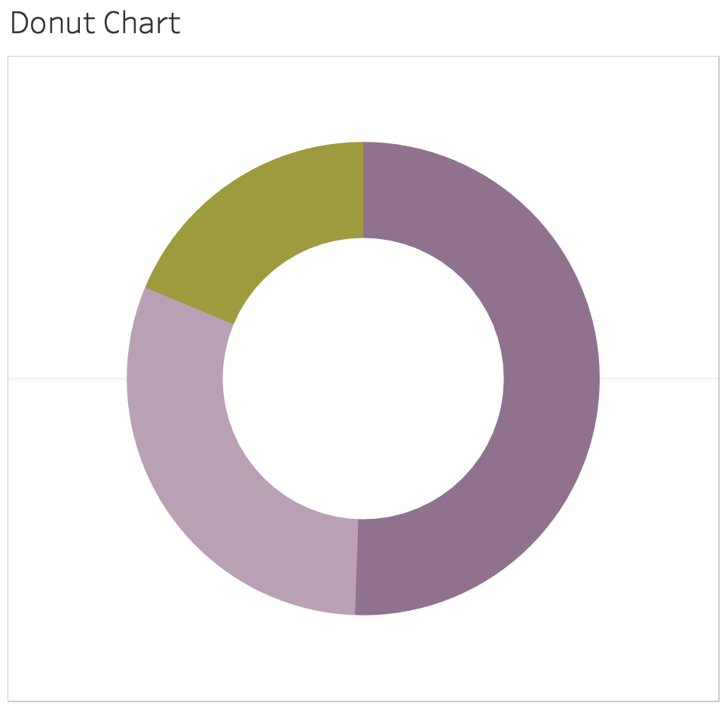
“Not Wrong” Graphs – Donut Chart

Slide 20
Other “Rules” For Part-to-Whole
Generally, you should indicate the “whole” – especially when illustrating multiple parts-to-whole.
More than 5-7 parts may overload the viewer’s ability to make comparisons.

